Slide 1
INSTRUCTIONS
Use Font size 22 to 28 and Font Style Times New Roman (body)
Do not change the Template: Heading / Title of the slides
Do not change font style or colours
Do not copy paste paragraphs: use only Bullet Points
Maximum slide Limit is 20 only
As per the number of supervisor allotted adopt slide-2 or slide-3
Please display the required meaningful Content or images or tables
Change the footer accordingly using insert tab then click on header & footer tab and edit it
Save the PPT with Register No, Dept and Review no, example: 23xxxxxxxxx_CSE

Slide 2

Title: Page Turner: A Smart Digital Library Platform for Unlimited Online Reading
Student Name: B Koumudi
Student ID: 2520090161)
Cluster: 1
Section: 4
Under the Guidance
of
Supervisor Name: MADHURI TSP
Assistant Professor
Department of CSIT

Slide 3
OUTLINE
Abstract
Existing System
Proposed System
System Architecture
Project Modules
Objectives
Co’s Attainments - FWD
Co1
Co2 …….. 5. Co5
Co’s Attainments - DSA
Co1
Co2 …….. 5. Co5
Screen Shots for FWD & DSA
Conclusion
Geo-Tagged Photos

Slide 4
Abstract
PageTurner is an innovative online reading platform designed to provide users with seamless access to a wide variety of books in digital format. Through a subscription model, users can enjoy unlimited reading for six months, accessing genres ranging from fiction and non-fiction to educational and self-help. The platform features an intuitive interface, personalized recommendations, and secure user authentication, ensuring a safe and engaging reading experience. With mobile and desktop compatibility, PageTurner aims to revolutionize how readers discover and enjoy books anytime, anywhere, while promoting digital literacy and convenient access to literature.

Slide 5
Existing System
In the existing system, most online reading platforms require users to purchase books individually or have limited free access. This makes reading expensive for users who want to explore many books. Some platforms also have limited features, poor organization of genres, and lack personalized recommendations. Additionally, accessing books across multiple devices may not always be convenient, which reduces the overall reading experience.

Slide 6
Proposed System
The proposed system, PageTurner, is a digital reading platform that allows users to access a wide collection of books through a subscription model. Instead of purchasing books individually, users can subscribe for a fixed period (six months) and read unlimited books from different genres. The platform provides a user-friendly interface, organized genre categories, and personalized recommendations to help users discover new books easily. It also supports access from multiple devices, allowing users to read anytime and anywhere, making the reading experience more convenient and affordable.

Slide 7
System Architecture
The PageTurner system follows a three-tier architecture consisting of the presentation layer, application layer, and database layer. The presentation layer is the user interface built using HTML, CSS, and JavaScript, which allows users to interact with the platform through a web browser. The application layer is developed using Node.js and Express.js, which handles the business logic such as user authentication, book management, and subscription services. The database layer uses MongoDB to store user information, book details, and subscription data. These layers work together to ensure smooth communication between the user interface and the database, providing a secure and efficient digital reading experience.

Slide 8
Project Modules
User Registration and Login Module This module allows new users to create an account and existing users to log in securely to the platform.
Book Management Module This module manages the collection of books available on the platform, including adding, updating, and organizing books into different genres.
Subscription Module This module allows users to subscribe to the platform for a fixed period (six months) to access unlimited books.
Search and Filter Module This module helps users easily find books using search options and genre-based filters.
Reading Module This module enables users to open and read digital books (PDF format) directly on the platform.

Slide 9
Objectives
To provide unlimited access to a variety of books through a single subscription.
To design an easy-to-use and responsive digital reading platform.
To implement secure user authentication for a safe reading experience.
To offer genre-based filters and personalized recommendations for users.
To support multi-device access for reading on mobile, tablet, or desktop.

Slide 10
Co’s Attainments - FWD
CO NO | COURSE OUTCOME(CO)
CO 1 | Apply Internet Fundamentals, HTML & Introductory CSS Styling
CO 2 | Apply HTML Forms, Semantic Tags & Comprehensive CSS Layouts
CO 3 | Apply JavaScript Programming Essentials
CO 4 | Apply JavaScript Interactivity, DOM
CO 5 | Apply Advanced Web Development & Deployment

Slide 11
Co’s Attainments - DSA
CO NO | COURSE OUTCOME(CO)
CO 1 | Analyze problem statements and reason about algorithmic efficiency using asymptotic notation (Big-O, Ω, Θ), recurrence relations, and empirical measurements of time and space complexity, in order to compare alternative solutions,Implement and analyze classical searching and sorting algorithms in Java (including linear search, binary search, bubble, selection, insertion, merge, quick), and justify the choice of algorithm for different input characteristics and constraints.
CO 2 | Design and implement Abstract Data Types (ADTs) using arrays and linked lists (singly, doubly, circular), perform typical operations (insert, delete, search, traverse, reverse, detect cycles), and reason about their trade-offs for different use cases.
CO 3 | Apply stacks and queues (including circular queues and deques) to model real-world workflows , selecting appropriate implementations (array-based or linked) based on performance considerations,Implement heaps and priority queues, and use them in scenarios that require prioritized processing , analyzing their performance compared to other linear data structures.

Slide 12
CO NO | COURSE OUTCOME(CO)
CO 4 | Design and implement hash-based data structures (hash tables with chaining and open addressing) and leverage Java Collections (List, Queue, Deque, Map) to build efficient, scalable solutions to realistic problems that demand fast lookup and updates.
CO 5 | Design, Develop and evaluate common practical applications for linear Data Structures.
CO 6 | Skill the students in such a way that students will be able to develop and create programs as well as applications in DS

Slide 13
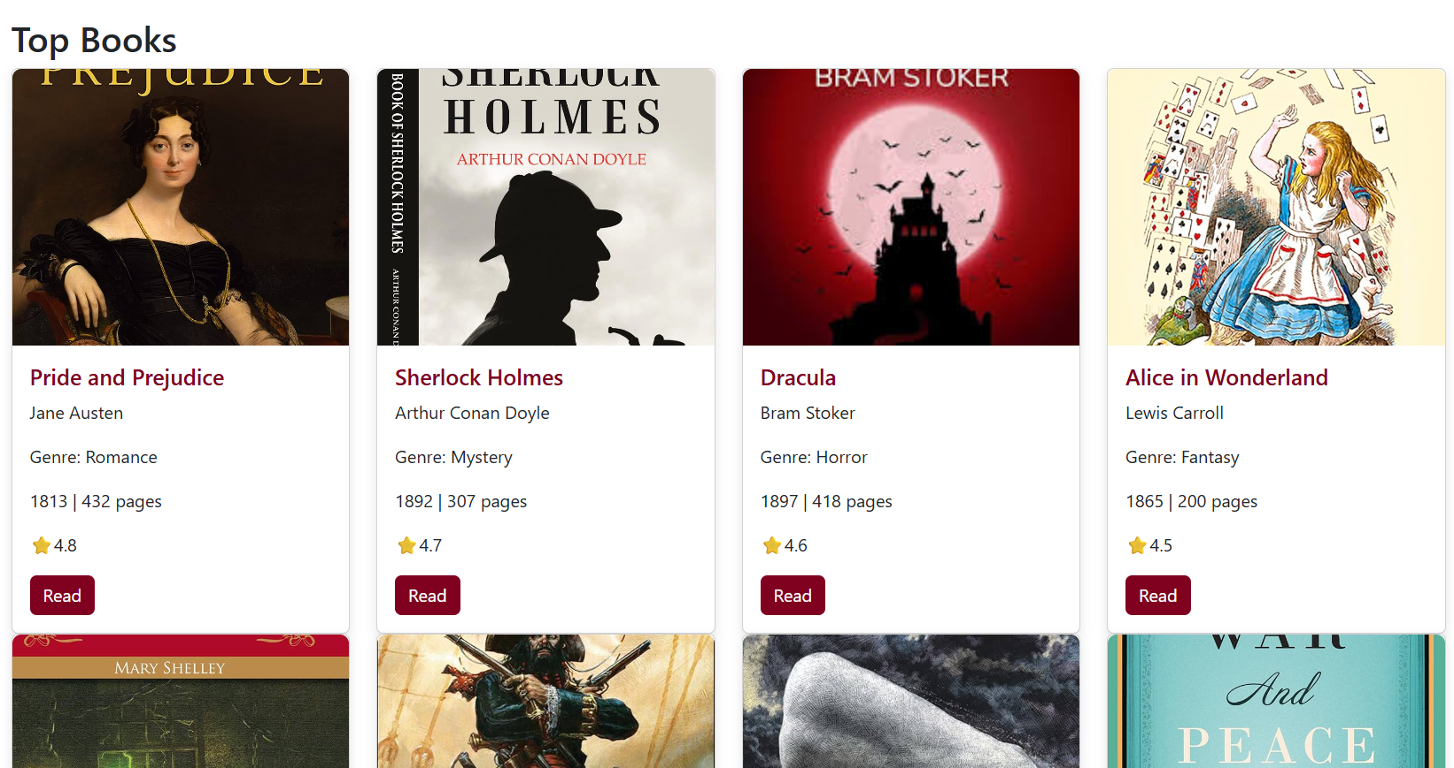
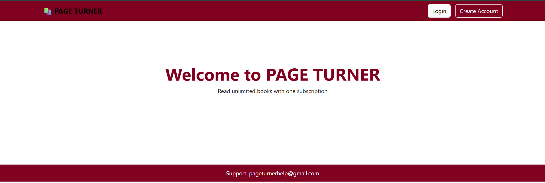
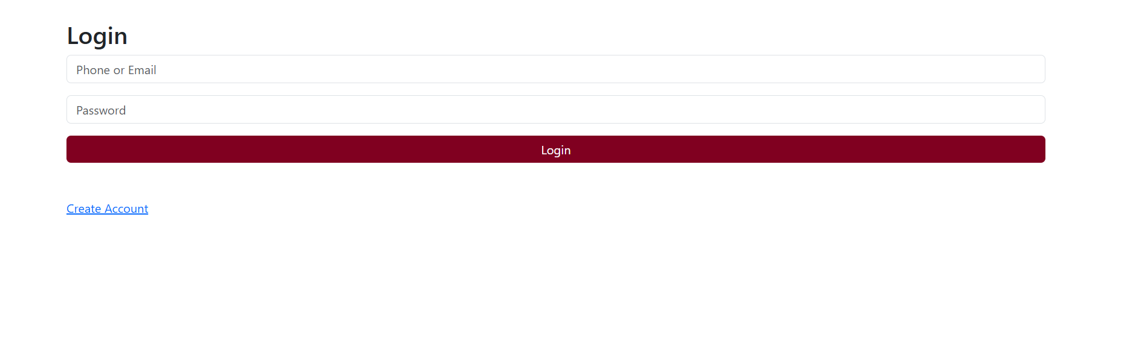

Screenshots for FWD

Slide 14
Conclusion
The PageTurner platform provides a convenient and modern solution for digital reading. By offering a subscription-based system, users can access a wide variety of books without purchasing them individually. The platform is designed with a simple interface, organized genres, and easy navigation to improve the overall reading experience. PageTurner makes reading more accessible, affordable, and flexible, allowing users to enjoy books anytime and anywhere. This project demonstrates how technology can enhance the way people discover and read books in the digital era

Slide 15
THANK YOU

